Slide 1
Sentiment Analysis

Slide 2
Tahsin Raihan Department of Computer Science & Engineering Rajshahi University of engineering & Technology

Slide 3
Introduction
Thesis Statement: To develop a robust sentiment analysis system leveraging ensemble machine learning techniques to classify text as positive, negative, or neutral.
Overview:
Data acquisition and preparation.
Exploratory data analysis (EDA).
Modeling and performance evaluation.
Ethical and legal considerations.
Key findings and recommendations.

Slide 4
Data Acquisition and Preparation
Data Sources:
Dataset: Twitter dataset from Kaggle
Text data includes labels for sentiment classification: Positive, Negative, Neutral.
Data Cleaning:
Removed special characters, stopwords, and numerical data.
Tokenized text and applied lemmatization for semantic normalization.
Addressed class imbalance using SMOTE (Synthetic Minority Oversampling Technique).
Ethical Considerations:
Ensured privacy of collected text data.
Checked for biases in labeling to avoid skewed predictions.

Slide 5
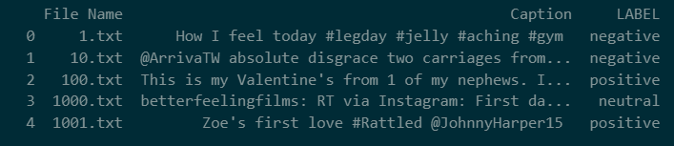
Showing the first few rows of dataset

Slide 6
Data preprocessing
Convert to lowercase
Remove special characters and numbers
Tokenize and remove stopwords
Lemmatization

Slide 7
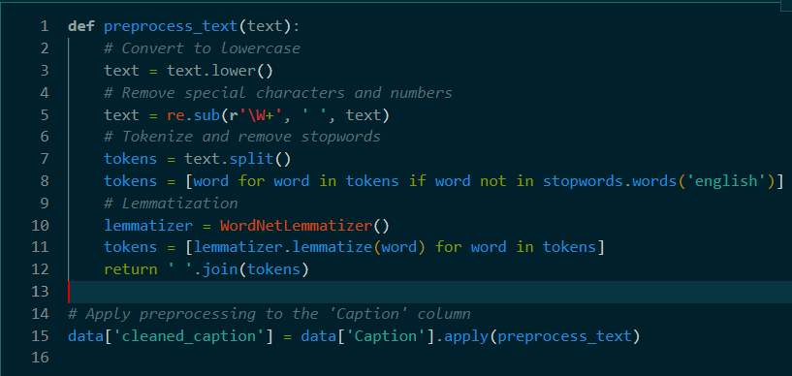
Code:

Slide 8
Data Analysis
Distribution of Sentiment Classes:
Visualized the percentage of each sentiment class (Positive, Negative, Neutral) in the dataset.
Identified imbalances in class distribution, requiring careful evaluation during model selection.
Common Words Analysis:
Analyzed frequently occurring words in each sentiment class.
Visualized using word clouds and bar charts to reveal patterns in text data.
Key Observations:
Noticed an uneven distribution of sentiment classes, influencing performance on minority classes.
Frequently shared keywords across sentiment classes emphasized the need for advanced feature extraction.

Slide 9
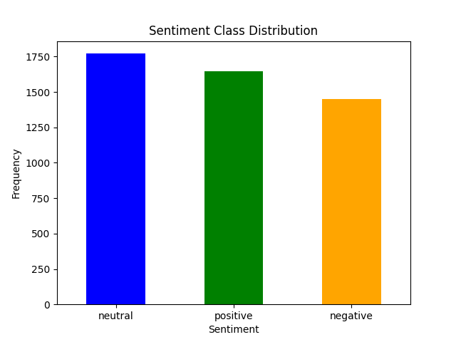
Srntiment Class Distribution Class

Slide 10
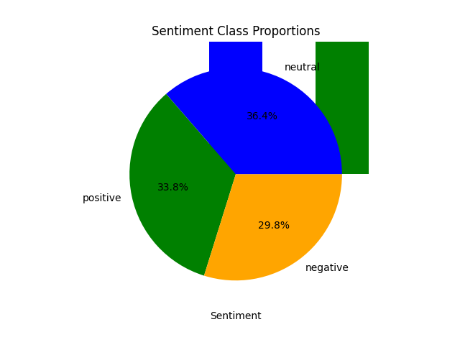
Sentiment class proportion pie chart

Slide 11
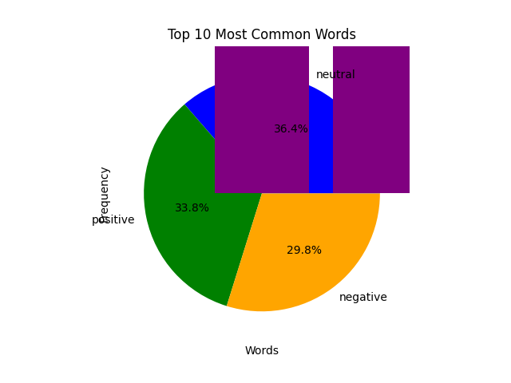
Top 10 most common words

Slide 12
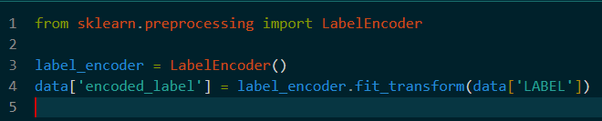
Encoding the labels (Positive = 2, Negative = 0, Neutral = 1)

Slide 13
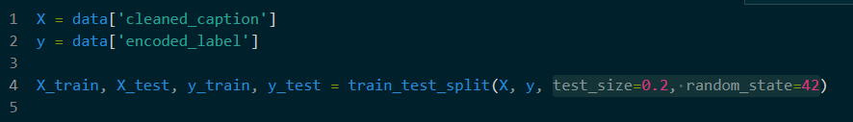
Splitting the data into test & train datasets(20%, 80%)

Slide 14

Text vectorization :

Slide 15
Modeling
Techniques Used:
Base Models:
Random Forest
SVM
Logistic Regression
Naive Bayes
KNN
Meta-Model:
Gradient Boosting Classifier
Stacking Strategy:
Combined predictions from base models to improve overall accuracy.
Performance Metrics:
Evaluated using accuracy, precision, recall, and F1-score.

Slide 16
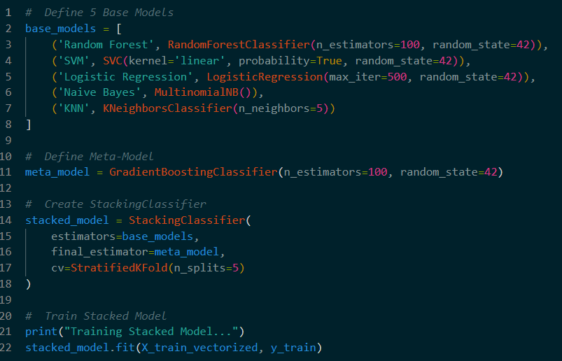
Code:

Slide 17
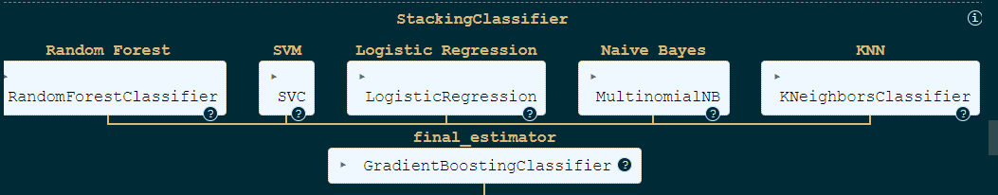
How the meta-model works

Slide 18
Results
Model Accuracy:
Achieved an overall accuracy of 70.94% on the test set.
Classification Report Highlights:
Negative: Precision = 70%, Recall = 76%, F1-score = 73%
Neutral: Precision = 67%, Recall = 62%, F1-score = 64%
Positive: Precision = 75%, Recall = 77%, F1-score = 76%
Macro and Weighted Averages:
Macro Average: F1-score = 71%
Weighted Average: F1-score = 71%

Slide 19
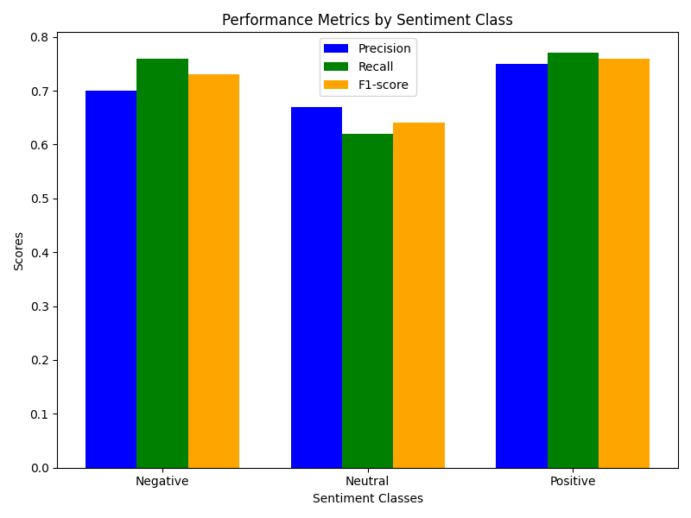
Performance Mertics

Slide 20
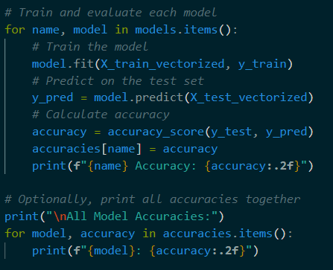
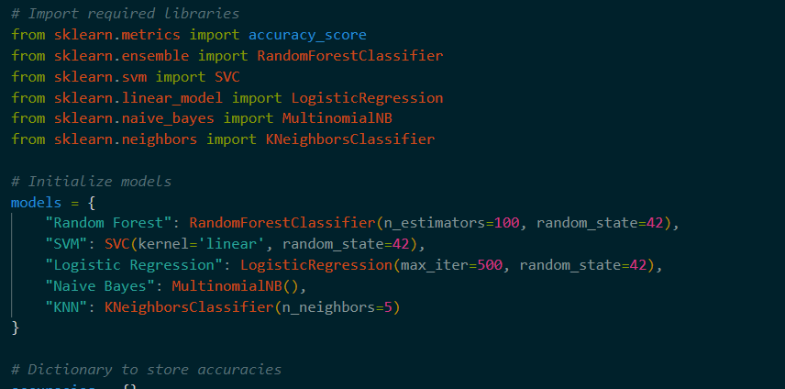
Analyzing each model accuracy individually

Slide 21
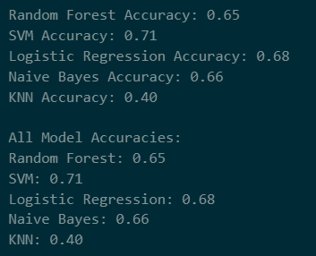
Output accuracy of each model

Slide 22
Front-End Deployment with Streamlit
The project includes an interactive Streamlit application for sentiment prediction. Users can input text through a web interface, and the system displays the predicted sentiment. Key features of the app include:
A clean, responsive interface.
Instant prediction output.
User-friendly error messages and warnings.

Slide 23
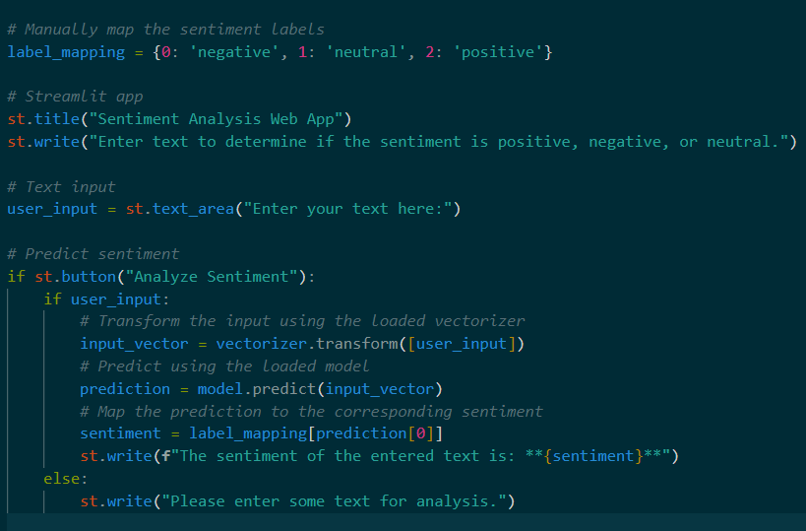
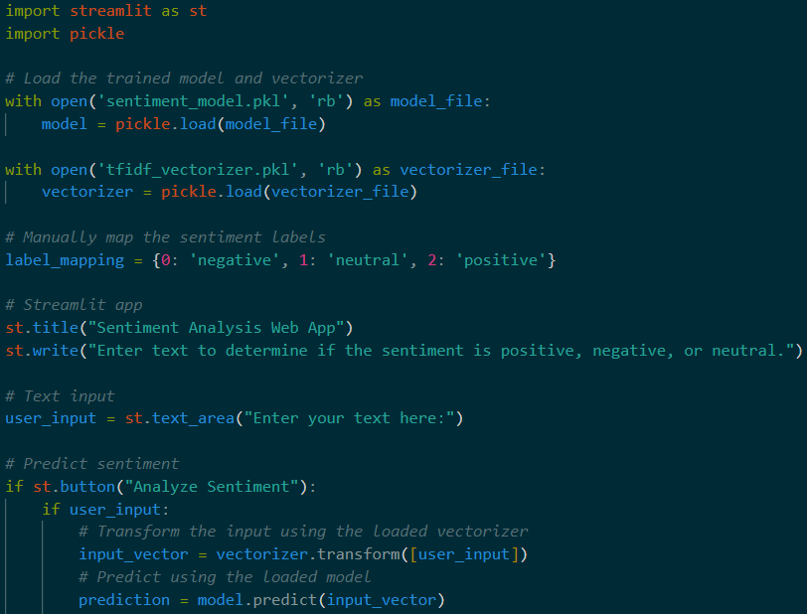
Code for Web App:

Slide 24
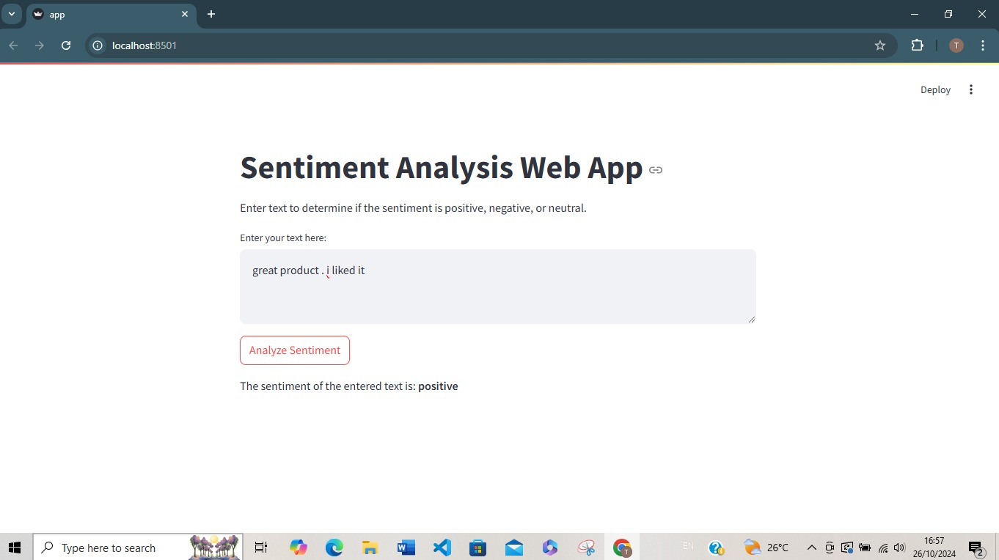
Web App:

Slide 25
Legal and Ethical Implications
Data Privacy Laws:
Anonymization of sensitive text data.
Data Security:
Measures include encryption and restricted access to the dataset.
Ethical Principles:
Ensured fairness in model predictions.
Transparent methodology to avoid bias in outcomes.

Slide 26
Conclusion
Key Findings:
Stacked model significantly outperformed individual base models.
Addressed data imbalance and improved class prediction consistency.
Recommendations:
Extend the model to handle multi-lingual datasets.
Integrate additional data sources for broader context in sentiment analysis.
Future Work:
Incorporate Deep Learning: Models like LSTMs or Transformers could improve accuracy on complex datasets.
Multilingual Support: Extend the application to handle non-English text.
Sentiment Strength: Quantify the strength of positive or negative sentiments.

Slide 27
Questions ?
Thank You

Slide 28
References
Books
Bishop, C. M. (2006). Pattern Recognition and Machine Learning. Springer.
Hastie, T., Tibshirani, R., & Friedman, J. (2009). The Elements of Statistical Learning: Data Mining, Inference, and Prediction. Springer.
Research Papers
Breiman, L. (2001). "Random Forests." Machine Learning, 45(1), 5-32.
Cortes, C., & Vapnik, V. (1995). "Support-vector networks." Machine Learning, 20(3), 273-297.
Rennie, J. D., Shih, L., Teevan, J., & Karger, D. R. (2003). "Tackling the Poor Assumptions of Naive Bayes Text Classifiers." Proceedings of the 20th International Conference on Machine Learning (ICML).
Datasets
Kaggle. https://www.kaggle.com

